Slide 1
Literary Studies as Pedagogy
A Moving Target

Slide 2
Using New Technologies As a Form of Literary Studies

Slide 3
Digital Emerson
Leveraging Digital Tools
Creating a Space for Thinking
Making Use VALUE
A Student-Centered Collective Archive
Literary Studies Becoming Digital

Slide 4
What’s In?
Communication
Access
Utility
What’s Out?
Static Reading
Knowledge Silos
Information for its Own Sake

Slide 5
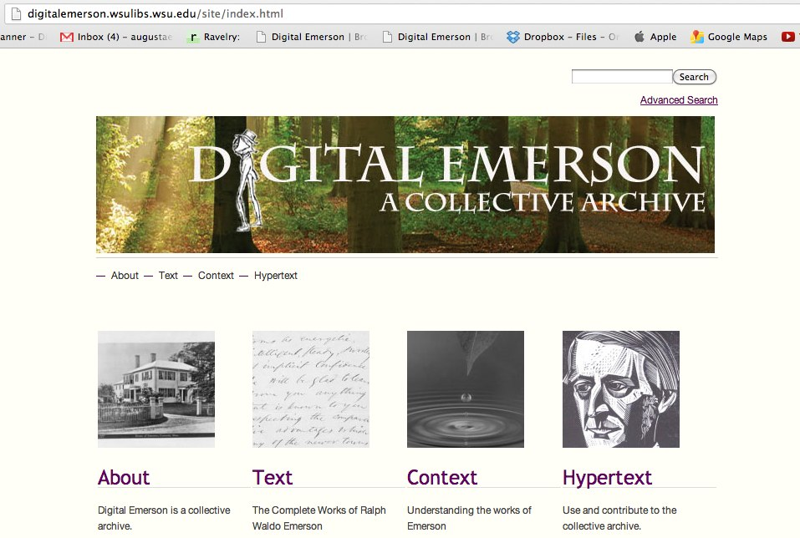
Causes for Change in the way we teach
The End of the “Expert Paradigm” Walsh, http://web.mit.edu/comm-forum/papers/walsh.html
“Collective Intelligence” Levy, http://www.ieml.org/IMG/pdf/2009-Levy-IEML.pdf
Open Classrooms—a “place” where knowledge-making is active and ongoing
.

Slide 6
Adjusting the Lens: How to Plan and Evaluate a Digital Project
The work of many meetings
Notes:
From design to implementation—we spent a great deal of time thinking about the possible choices, how they might interact and shape the viewer experience and our own ideas….as a result—the syllabus has to change to make room for these discussions. A new emphasis—on process, knowledge-making, not storing. Also—a basic assumption is made here that students come to class with interests of their own—and we need to find ways to leverage those interests…the collaborative digital project is a good model for this.

Slide 7
A New Center
Reader/User
Hypertext
Context
Text
Project Goals
Students
Interests
A New Rhythm

Slide 8
Leveraging Student Interests

Slide 9
Ecocritical Interests
Notes:
We used the CONTEXT section of the site to present focused material according to a variety of interests….this student had a particular interest in ecocriticsm.

Slide 10
Transatlantic Influences
Notes:
This student was from Costa Rica and was interested in how Emerson influenced the Spanish-speaking world

Slide 11
Not just textual

Slide 12
Incorporating New Technology and our own Teaching Tools

Slide 13
What’s New? Next Steps?

Slide 14
What’s Newer?
Ibook Author—Free, mac-based software to create multi-media ibooks. Boston College Undergraduate Project

Slide 15
Annotatable Text

Slide 16
Video Student Commentary

Slide 17
Incredible control over the look/advantage over OMEKA

Slide 18
What we need to do next:
Cross Institutional Collaboration
Connect to the Scholarly Journals
Form Broader Networks
Interest Your Students to Make Connections with local outlets—Middle school and high school visits, set up a reading group at a local library, Senior Center, or Assisted Living Residence
Notes:
As great as interdisciplinary work is, this still tends to conform to the sage on the stage model. With cross-institutional collaboration, students and teachers get more peer-to-peer learning while learning how to collaborate more fully.
The resource that could—and should—be leveraged more fully are the scholarly journals in the field. Boston College student project tapped their professors network and their school’s financing to hold a conference and also attract the work of major scholars in the field.

